Slide 1
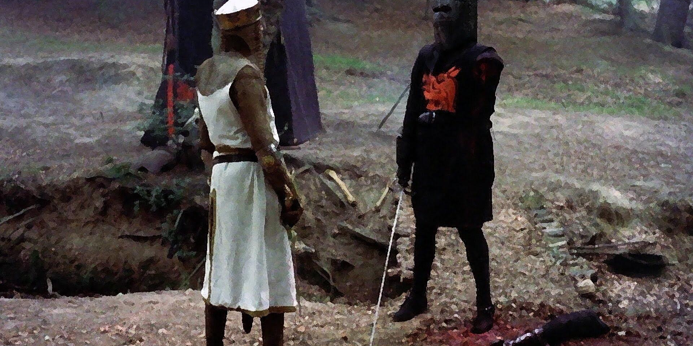

Duel-It
Team Upsilon
Jonah Belback, Jay Suggs, John Darnall

Slide 2
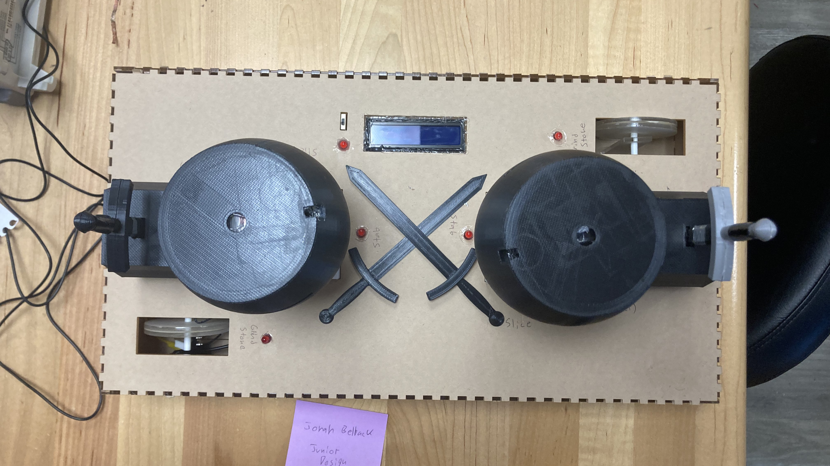

Slide 3
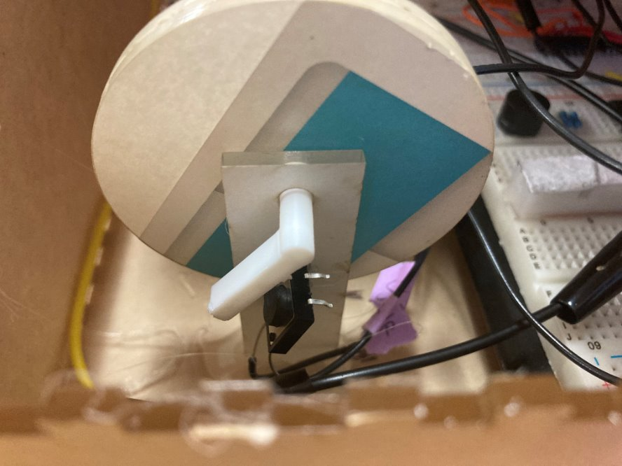
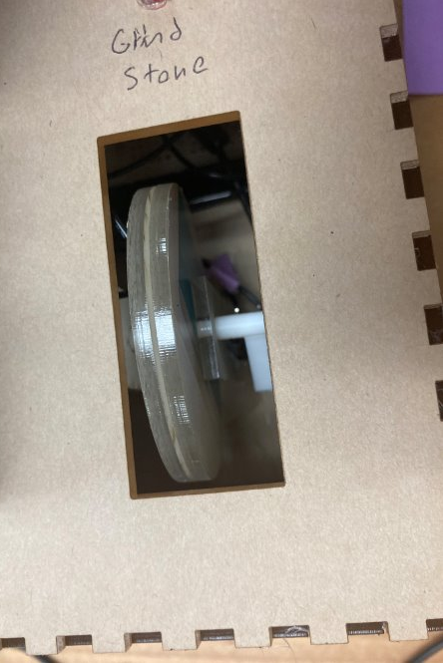
Grindstone

Slide 4
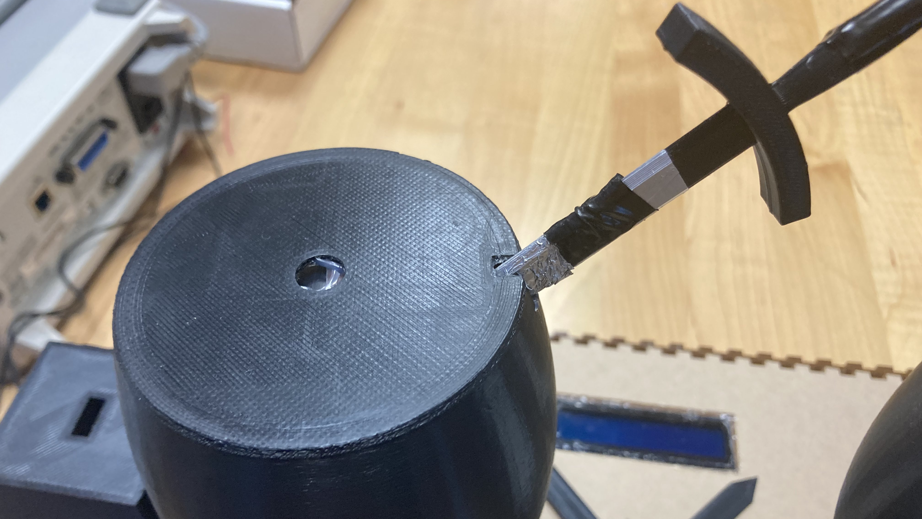
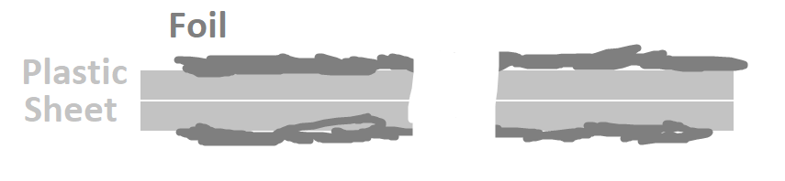
Stab

Slide 5
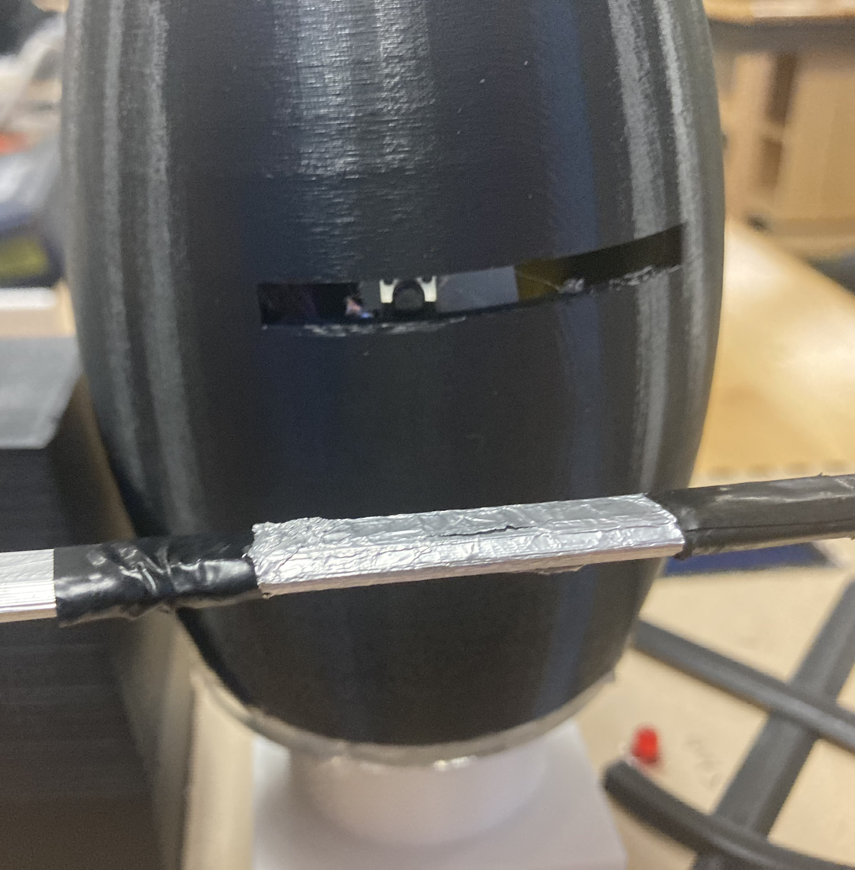
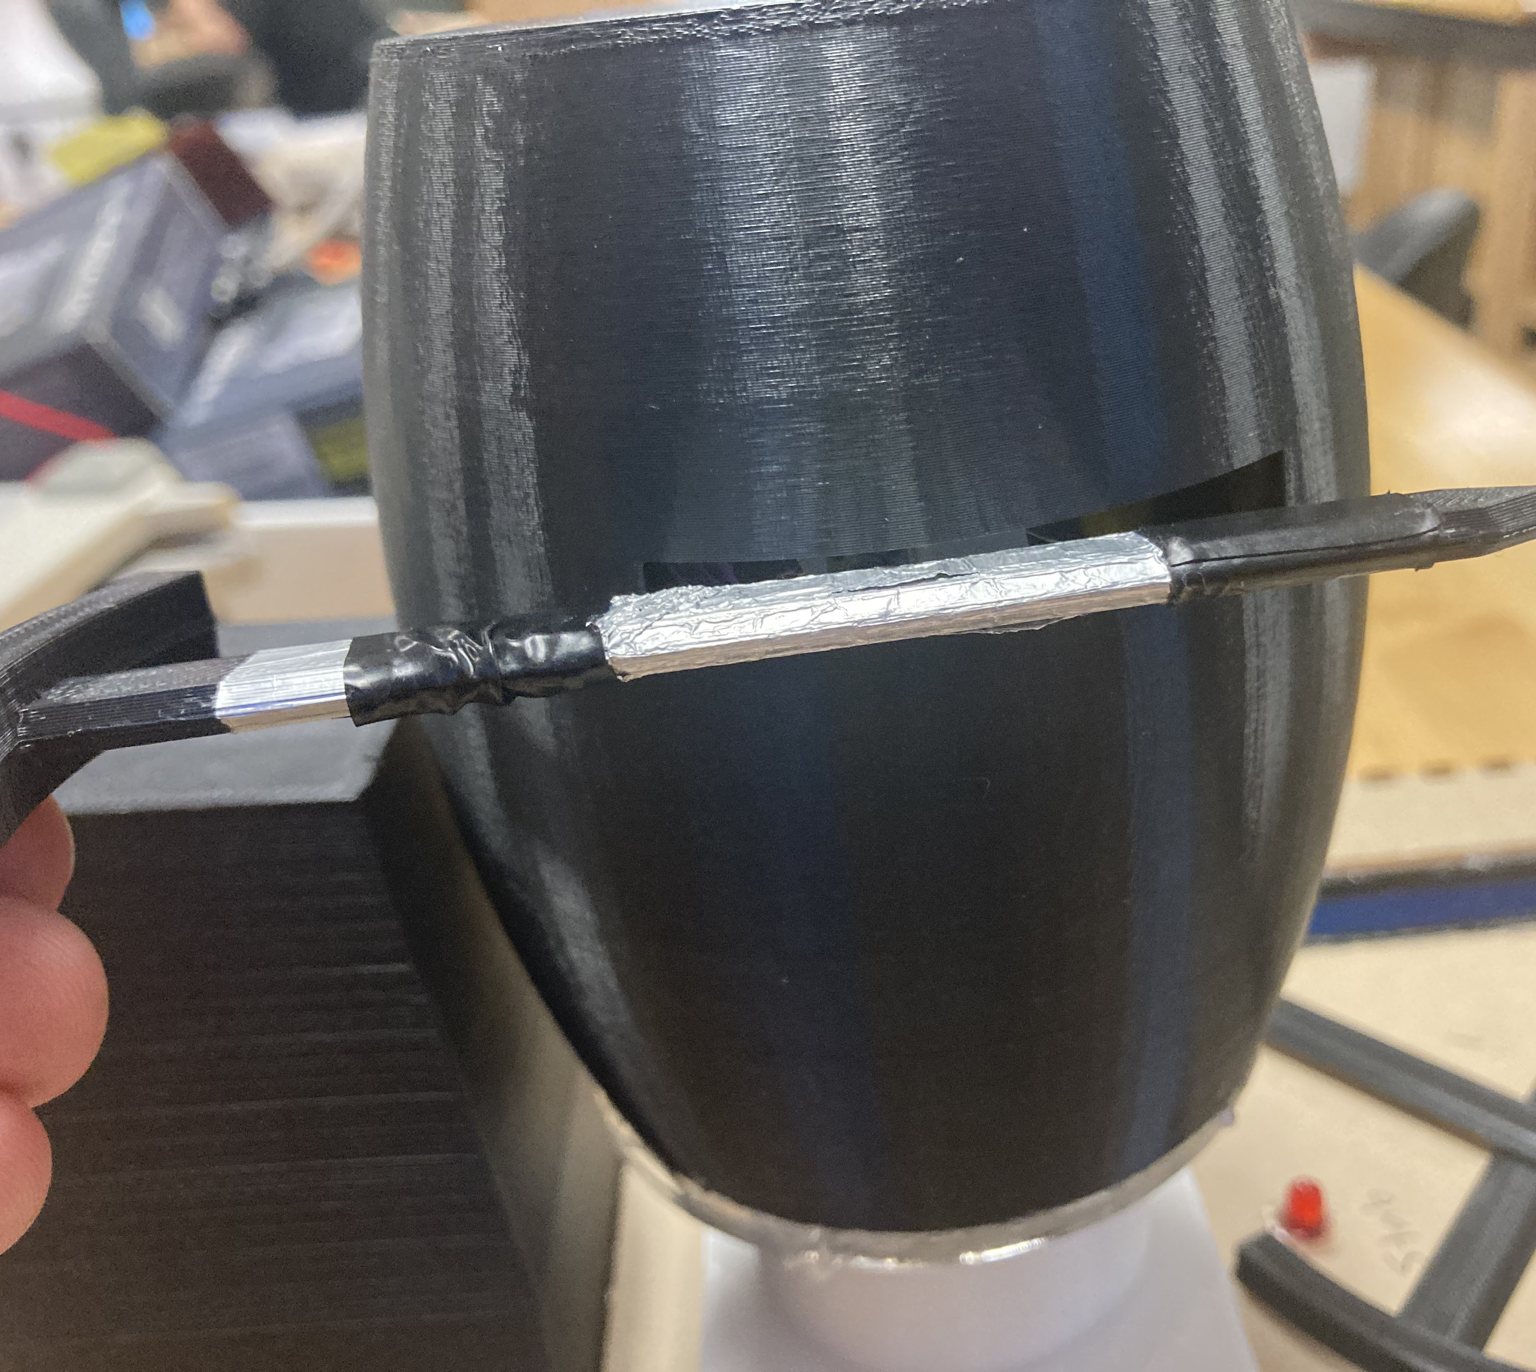
Slash

Slide 6
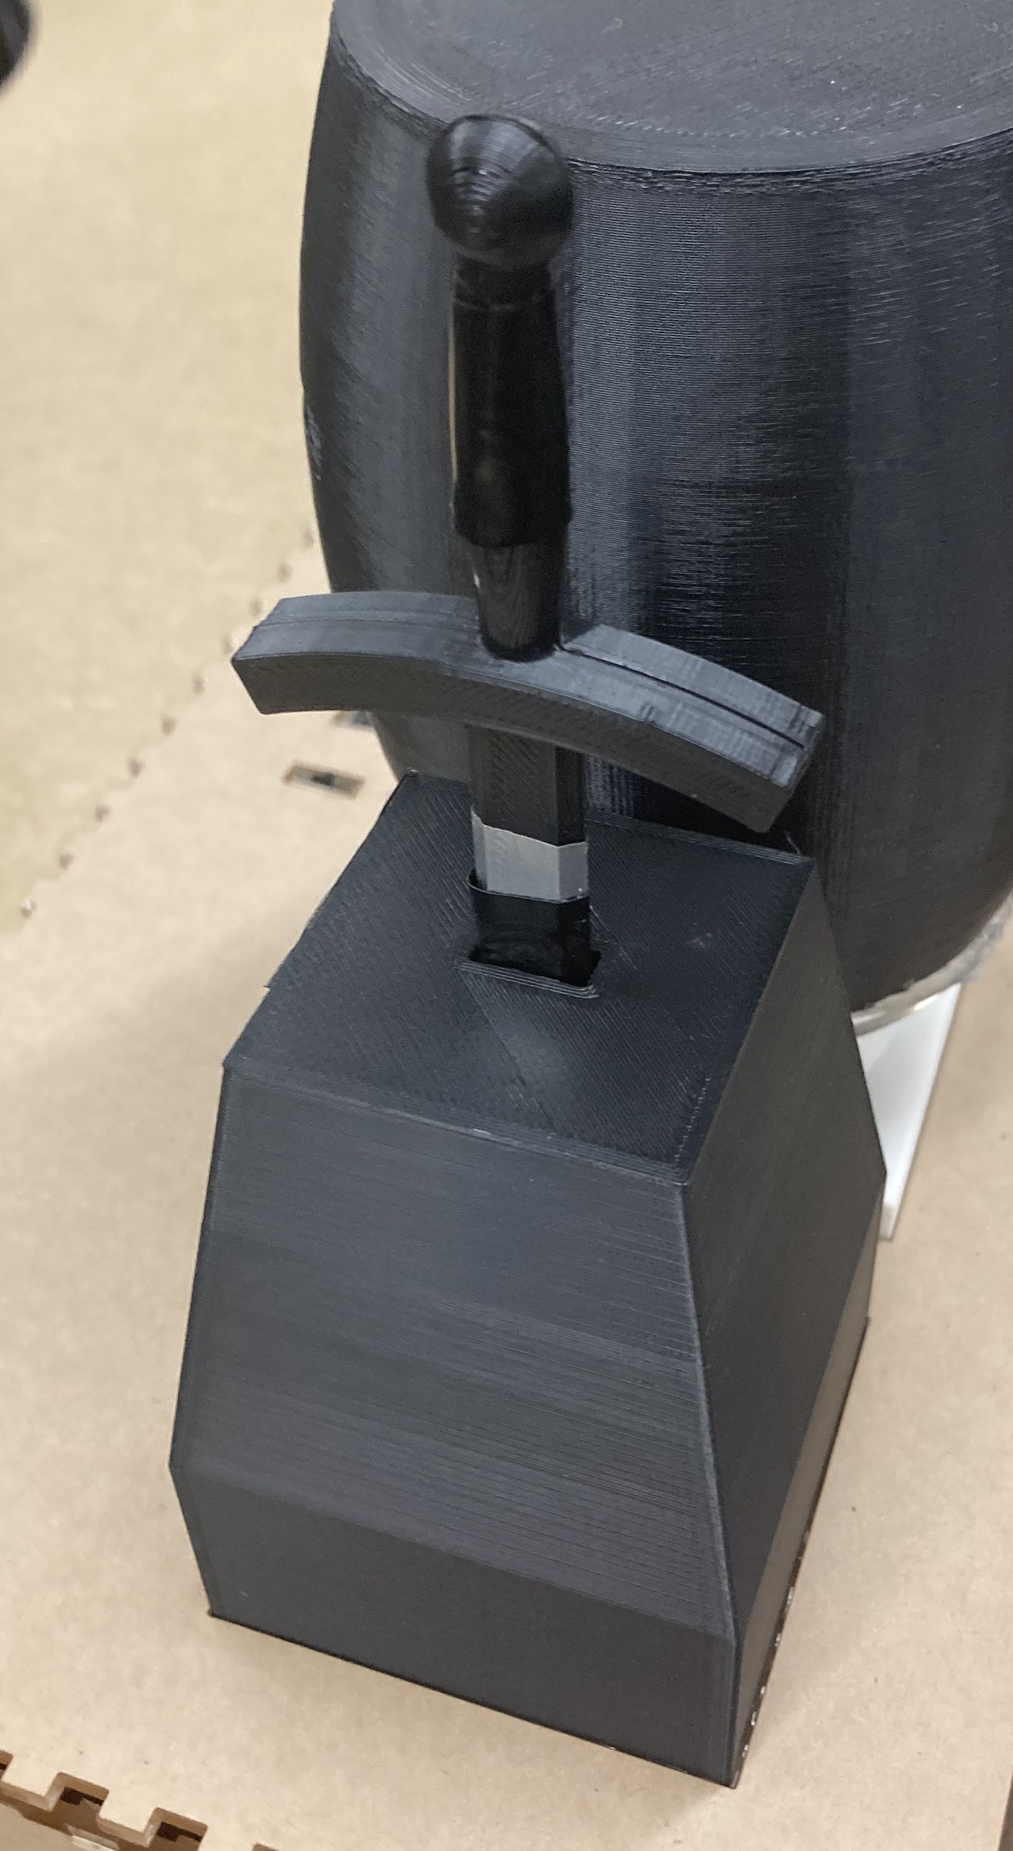
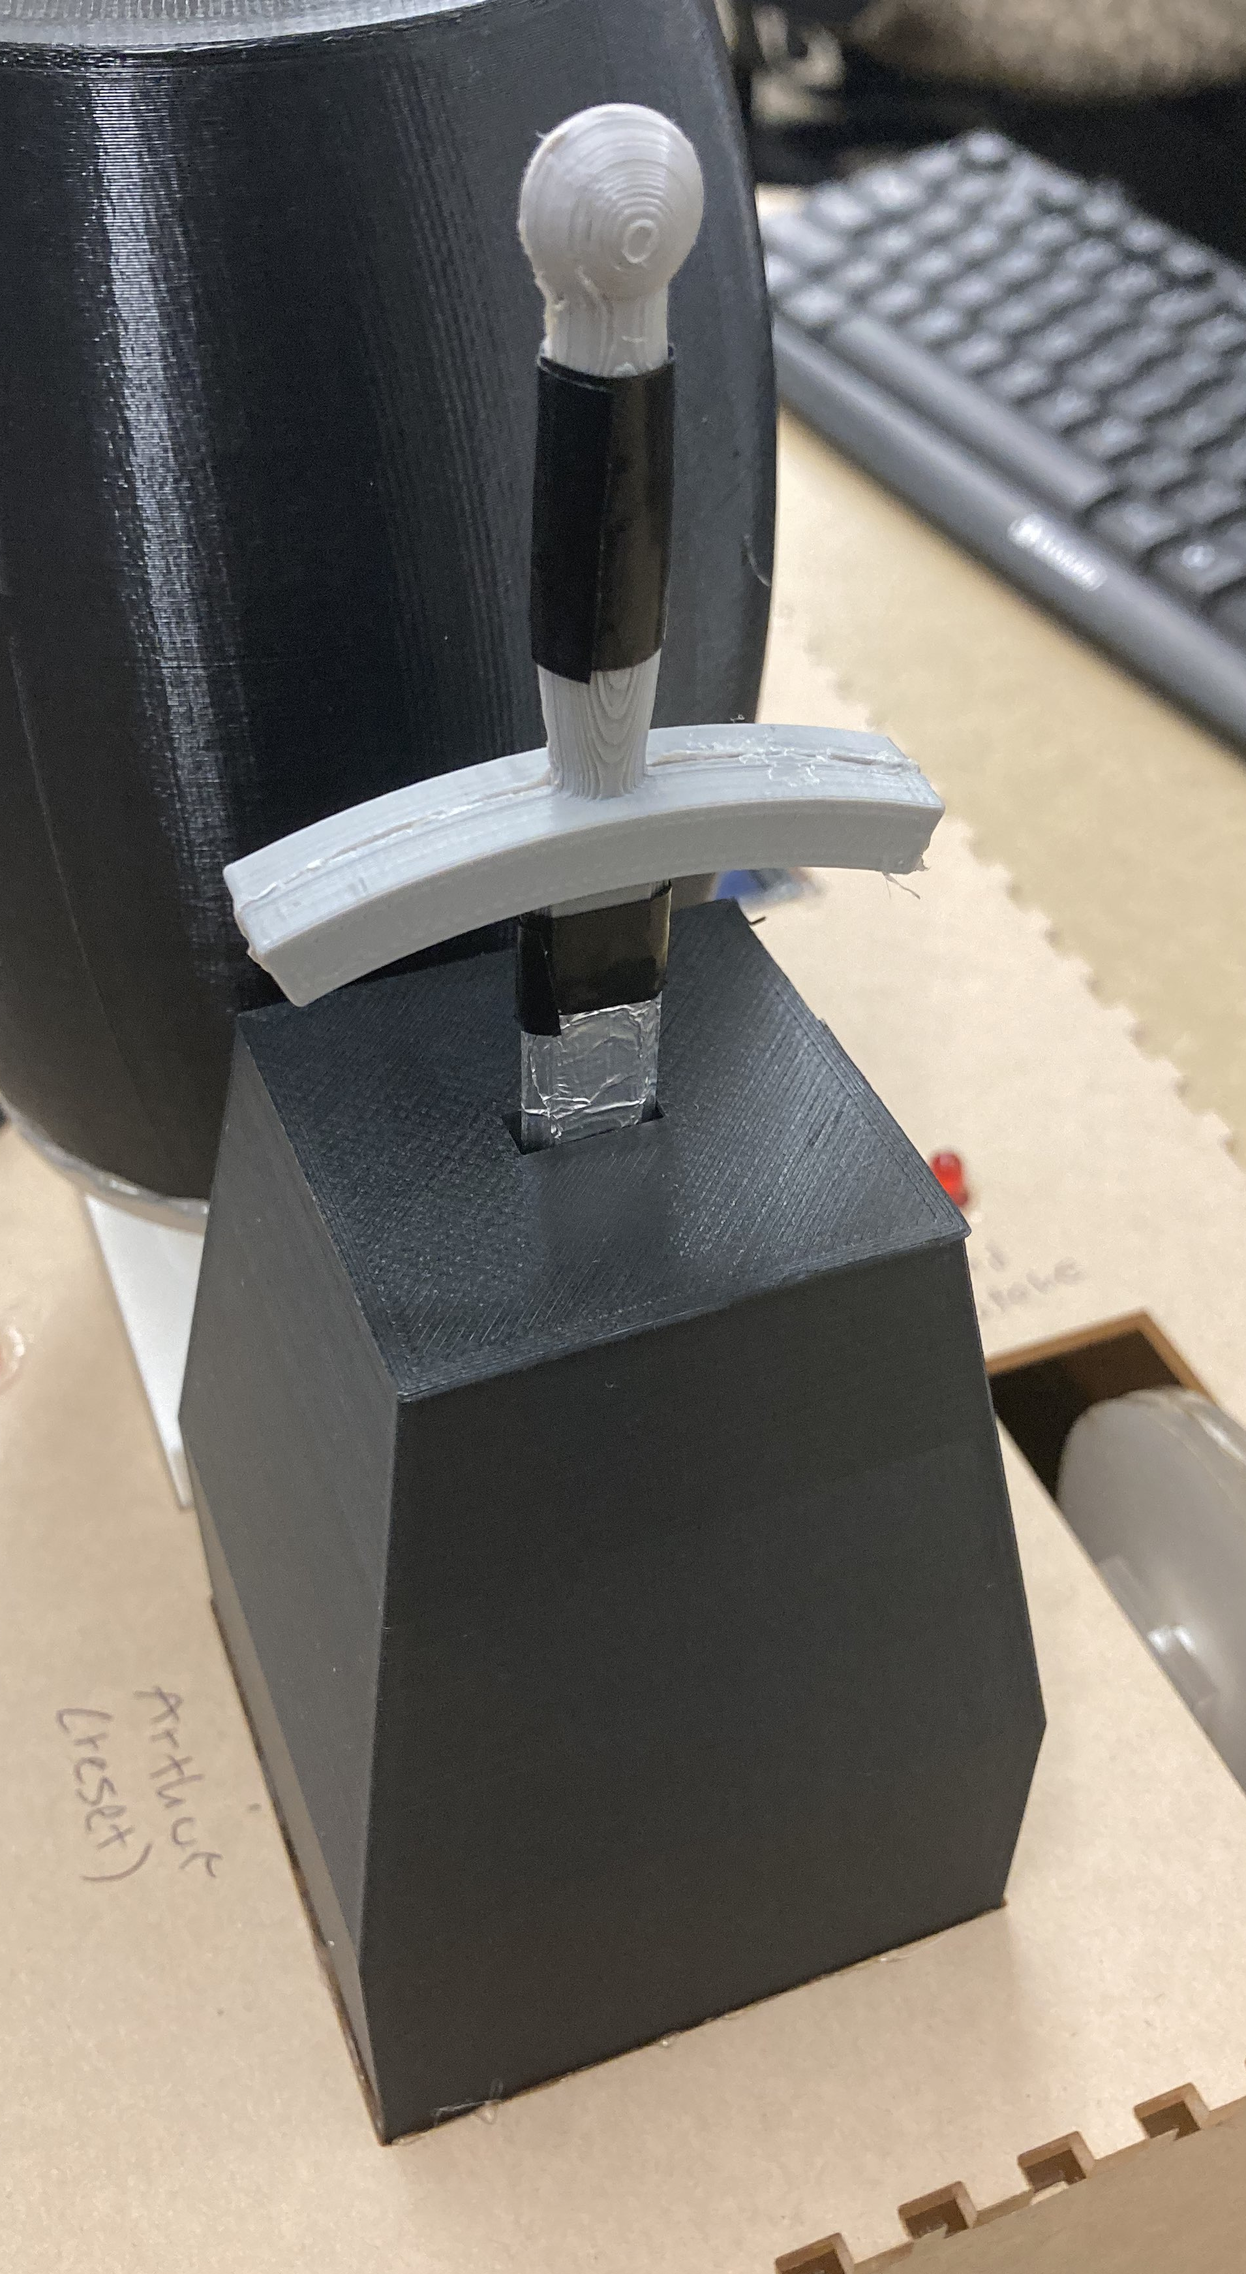
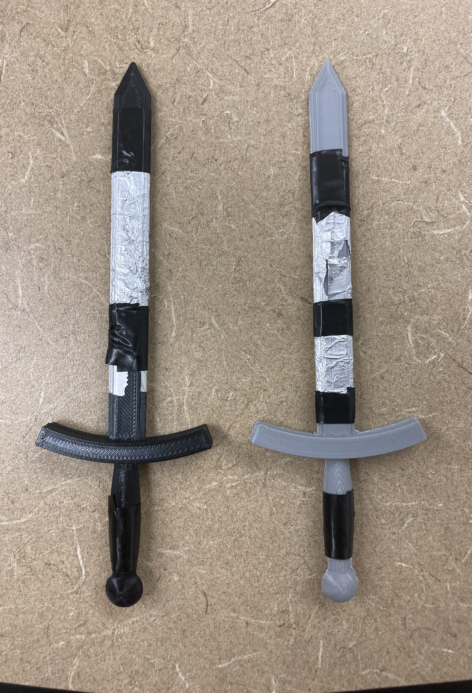
Arthur Stone (Reset)

Slide 7
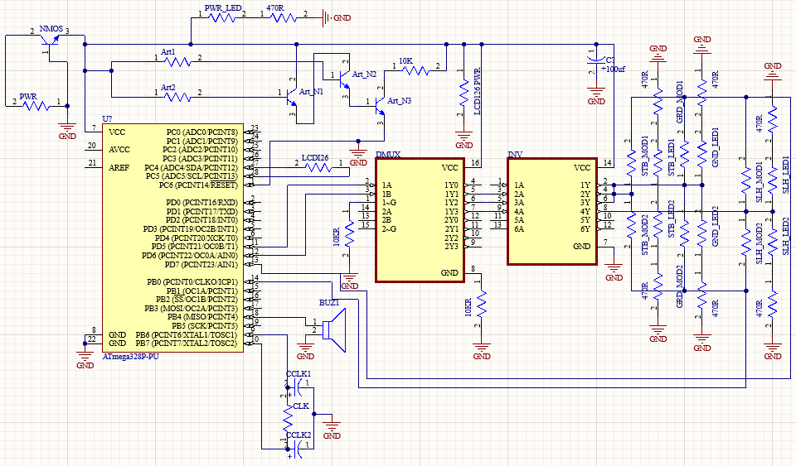
Third Iteration

Slide 8
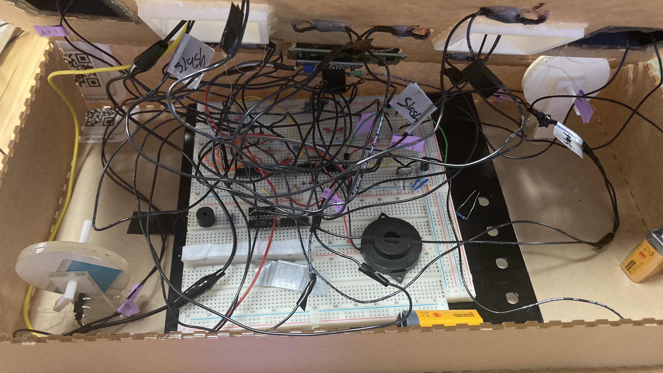
Consequences

Slide 9
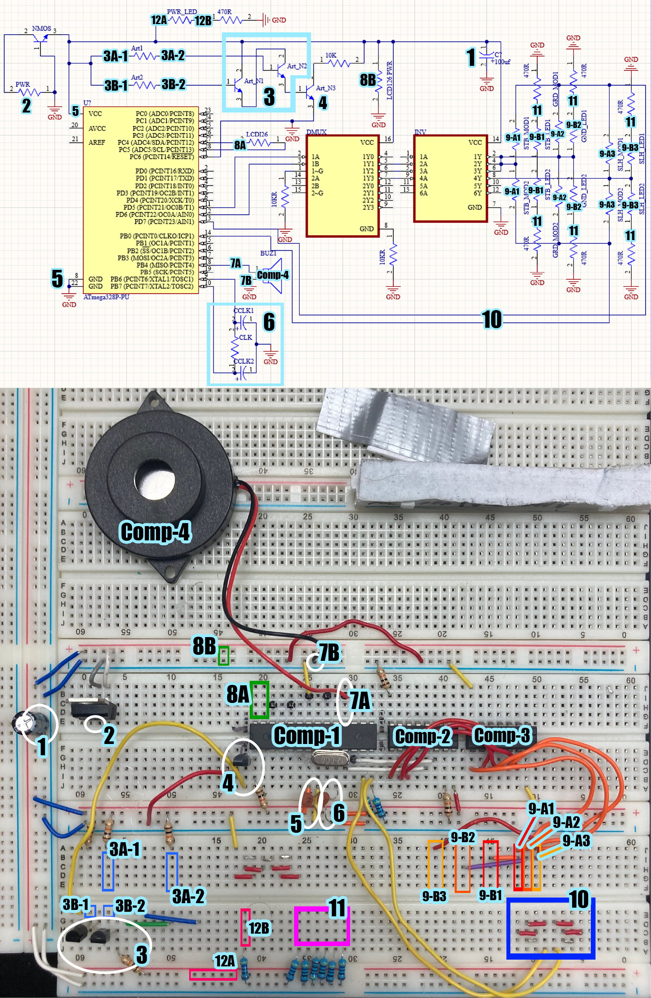

Slide 12
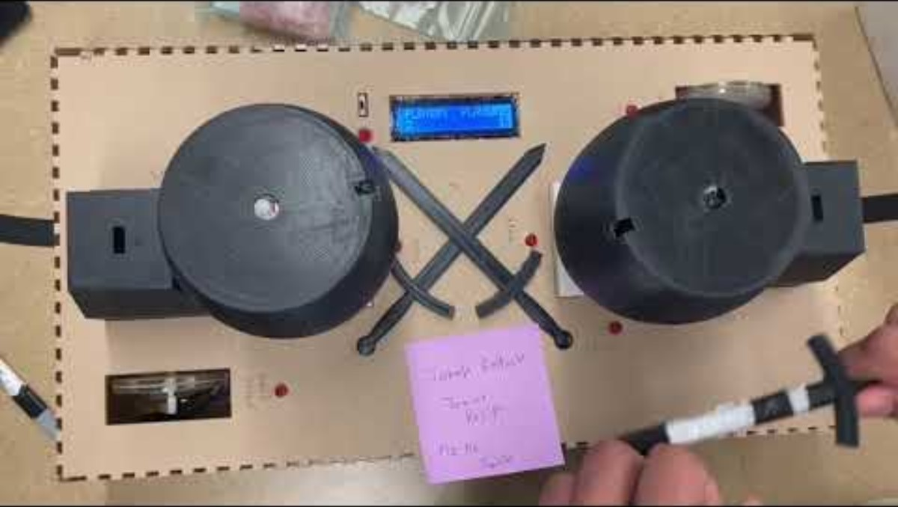
"Demo" video - Draw
Removed War-Cry as we couldn’t get the mic to work as we wanted to. We should've just bought a sound sensor instead of trying to make our own version
"Parry" was replaced with "Grindstone"
All 3 other modules work as intended
Due to the wiring rats-nest, it is very sensitive and only works in this state where the board is upside-down and sideways.
The Modules using metal contact do not work well as it was difficult to make the foil to behave exactly how we want due to its mailability
We tried using tin soda cans, but it didn’t conduct well

Slide 13
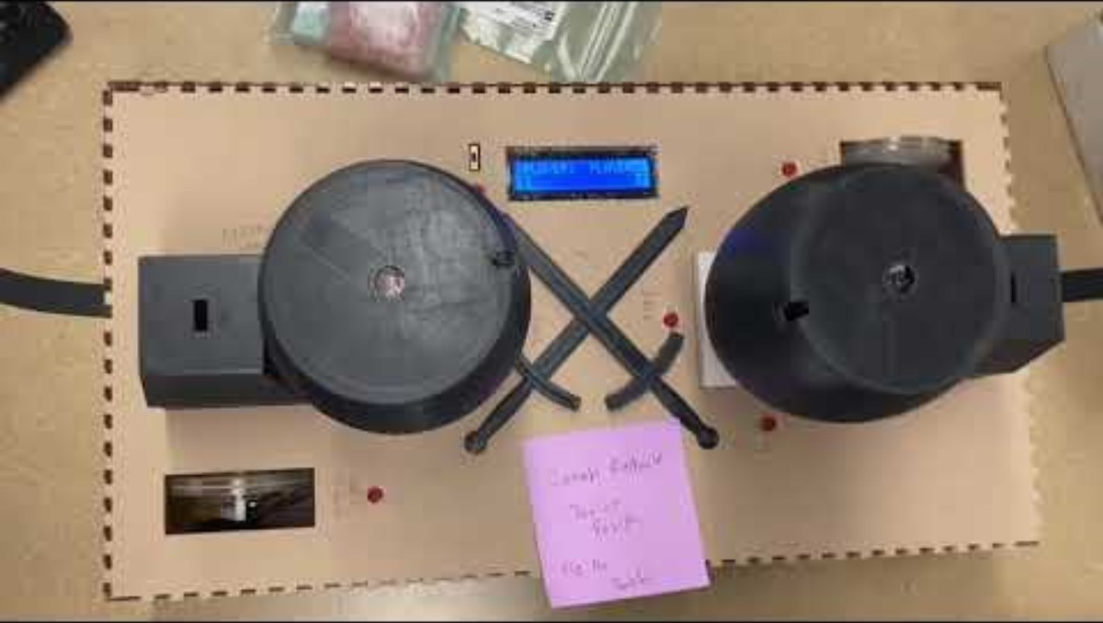
"Demo" video - Win
A player can win if they reach 99 points first or both players fail with one ahead by 3 points (expected)

Slide 14
Conclusion
What didn't
Modules using conductive pads are unreliable
Hard to insert/remove swords
Hard to create right
Sensitive, may break within several uses
Difficult to assemble onto enclosure
Didn't account for resistors in PCB forcing us to use breadboard for the Presentation
Made a highly sensitive rat-nest that made it extremely difficult to assemble
Unable to make a live demo in a proper manner where the wires aren't in a bad state or shorting
Couldn’t create own sound sensor
Circuit found when proposal was made was a sham
What Worked as expected
Programming
Decoder to reuse ports
LED Display
LEDs
Buzzer songs and tones
Enclosure design
2 Player versus
Everything in final proposal works, was created as expected, and was delivered besides ------>

